Slide 1

LD Hub: a centralized database and web interface to perform LD score regression that maximizes the potential of summary level GWAS data for SNP heritability and genetic correlation analysis
Zheng et al., Feb 2017
Features: (i) Calculate how inflated your GWAS results are due to confounding
(ii) Check genetic correlation between your trait of interest and
(lots of) other traits
(iii) Calculate SNP heritability for your trait of interest
Background reading:
1- LD score regression distinguishes confounding from polygenicity in genome-wide association studies. Bulik-Sullivan et al, 2015, Nat Genet
2- Partitioning heritability by functional annotation using genome-wide association summary statistics. Finucane et al, 2015. Nat Genet
Journal club: 03/03/17
Mesut Erzurumluoglu
Notes:
The following slides are on LD hub, but also LD score regression
Although just published a month ago, it is cited over 10 times – showing the potential of making things available as a preprint (e.g. in BioRxiv)

Slide 2
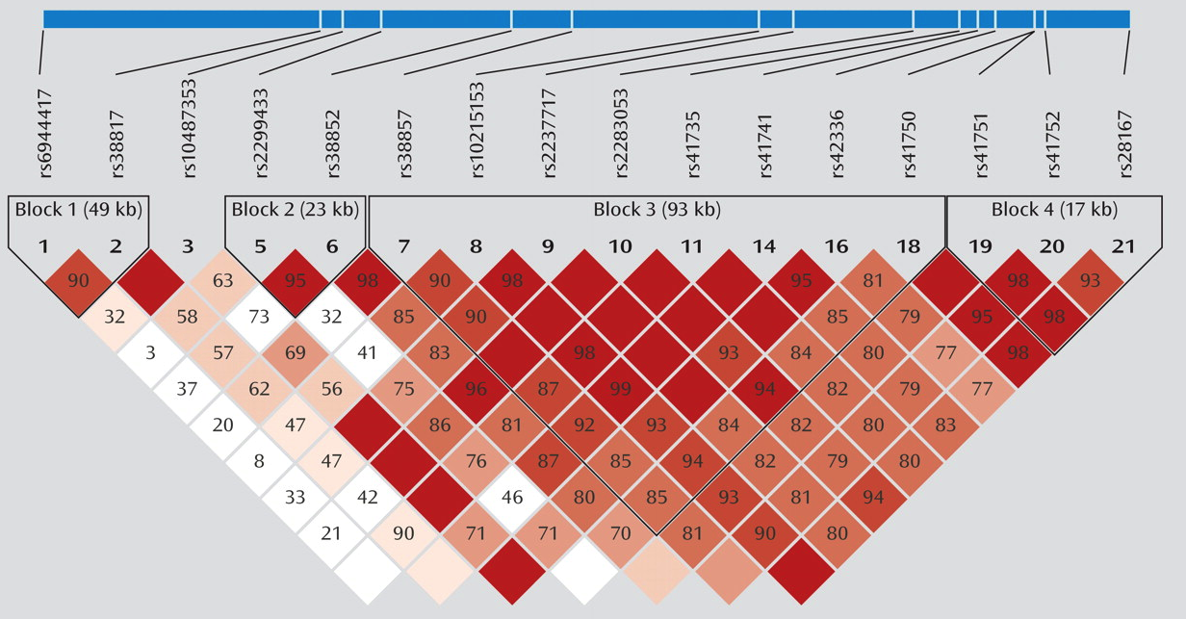
Population Genetics 101
Linkage disequilibrium (LD)
Non-random association of alleles at two or more loci (if random alleles at two loci co-inherited 50% of the time)
For details, see my last journal club slides (dated: 21/09/16)
Haploview software
Notes:
See journal club for ‘HAPRAP’ paper (Zheng et al, Feb 2017) – 21/09/16

Slide 3
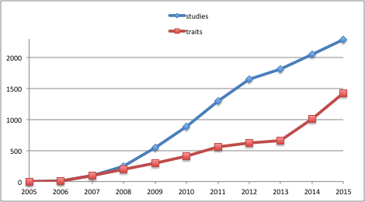
GWAS summary-level resource in the post-GWAS era
11 years of genome-wide association studies: >2000 GWAS
GWAS summary results are valuable resource for methods, e.g. LD score regression, two-sample Mendelian randomization, fine mapping, imputation
Time consuming and challenging to collect and centralize data, harmonize information and setup an automated analysis pipeline

Slide 4
Introduction to study
GWASs provide a powerful approach for identifying variants associated with complex human diseases/traits
Lots of publicly available GWAS summary results (not individual-level data)
Both polygenicity and confounding biases can cause an inflated distribution of the test statistics in GWAS
Distinguishing inflation from a true polygenic signal from bias is important as there is strong evidence that polygenicity accounts for the majority of the inflation in test statistics in many GWASs of large sample size
LD Score regression quantifies the contribution of each by examining the relationship between the test statistics and their ‘LD score’. The LD Score regression intercept can be used to estimate a more accurate correction factor than genomic control (λ)
LD Score regression can also be used to:
Estimate the SNP heritability of complex traits/diseases
Partition this value into functional categories (e.g. gene sets)
Estimate the genetic (and phenotypic) correlation between different phenotypes
LD hub (ldsc.broadinstitute.org) provides a user-friendly interface to make use of all the above in a reliable and efficient manner
Notes:
Polygenicity: many small genetic effects
Confounding biases: e.g. cryptic relatedness and population stratification
SNP heritability: total “narrow-sense” (additive) contribution of SNPs to a trait's heritability

Slide 5
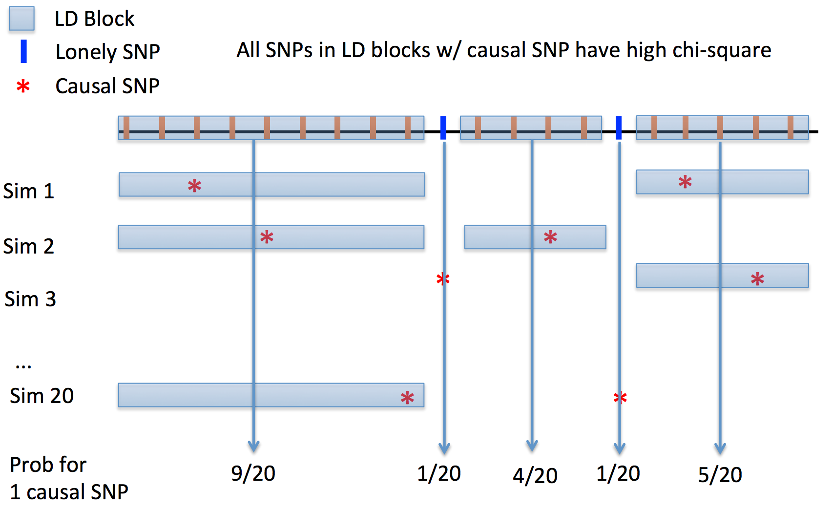
Theory: LD score regression (LDSR)
Basic idea: the more genetic variation a SNP tags, the higher the probability that it will tag a causal variant. In contrast, LD scores shouldn’t be correlated with population stratification
Notes:
LD score of a SNP= sum of r2 of all SNPs within 1cM (~1Mb) – currently computed using only HapMap 3 SNPs
cM: distance between SNPs for which the expected probability of a crossover event happening in a single generation is 1%

Slide 6
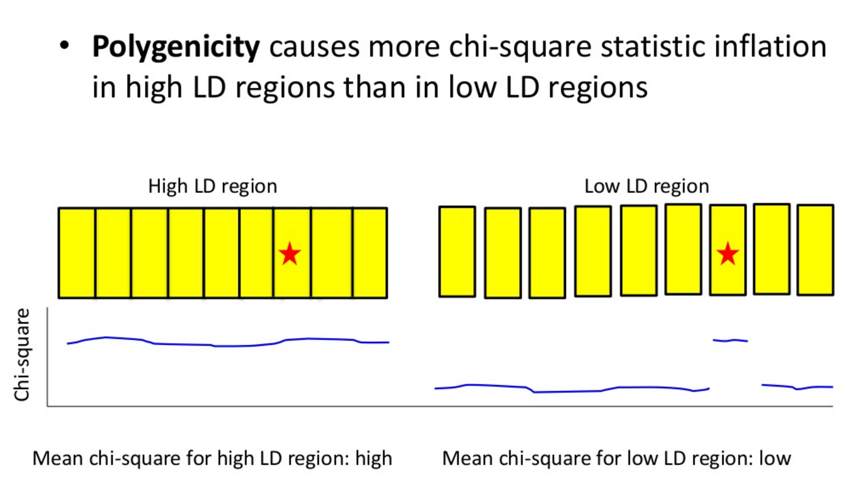
LD Score regression
Estimate LD scores from a reference panel
Regress chi-squared statistics on LD scores
Image source: www.slideshare.net/bbuliksullivan/
Notes:
The variants that tag more of the genome, will have higher LD scores.
Beta/se=z score

Slide 7
LD Score Regression
Univariate analysis
Bivariate analysis
LD Hub regresses test statistics from genome-wide SNPs against their LD scores. The slope is the SNP heritability of the trait. The intercept minus one from this regression is an estimator of the mean contribution of confounding to the inflation of the test statistics. Such an estimate is a more accurate measure of the test score inflation than genomic control.
In a bivariate setting, LDSC regress the Z score from two traits against the LD scores. The slope is the genetic correlation between two traits and the intercept of bivariate regression protects such regression from sample overlapping of two GWASs
Notes:
Top two are different trait e.g. bipolar disorder and schizophrenia test statistics
X2 is Z score squared: Z1st x Z2nd, then regress on LD score
Sample overlap did not bias the results – phenotypic correlation taking into account sample overlap

Slide 8
GREML v LD score regression
GREML: Genetic restricted maximum likelihood method
Main paper: “Common SNPs explain a large proportion of the heritability for human height” Yang et al, 2010. Nat Genet
Part of the well-known GCTA package
Requires individual-level (genotype) data
Largest meta-analyses are conducted via summary statistics
Computationally expensive algorithm at large sample sizes – variance components method
Run time depends on (i) sample size and (ii) no of traits analysed
Notes:
45% of variance can be explained by considering all SNPs simultaneously; most of the heritability is not missing but has not previously been detected because the individual effects are too small to pass stringent significance tests.

Slide 9
LD Hub for LDSR
LD score regression analysis pipeline
QC other GWAS summary result
QC your GWAS summary results
LD score regression analysis
Download/ask for data
Harmonise data formats
Traditional
A few hours to months
A few days to months
A few days to months
Results
Repeat process for another trait comparison
Reliable and replicable?
Upload GWAS summary results
Select options (i.e. click a few buttons)
Results for up to 175 traits
LD hub
A few minutes
A few minutes to a couple of hours
Results: (i) Calculate lambda for LD score regression, (ii) Calculated SNP heritability, (ii) Calculated genetic correlation between up to 177 traits (as of Mar 2017) and your trait of interest

Slide 10
LD Hub overview
LD Hub
Database
219 publicly available
GWAS traits
GWAShare Center:
Summary data sharing & user contribution
Test Center:
On-the-fly LD score regression analysis pipeline
Lookup Center:
Existing LD score regression results lookup
Notes:
In the LD Hub, we have four major components: a database of 177 publicly available GWAS traits, a test center of automate LDSC analysis pipeline, a lookup center for existing LDSC results lookup and a GWAShare center for sharing summary data with the community

Slide 11
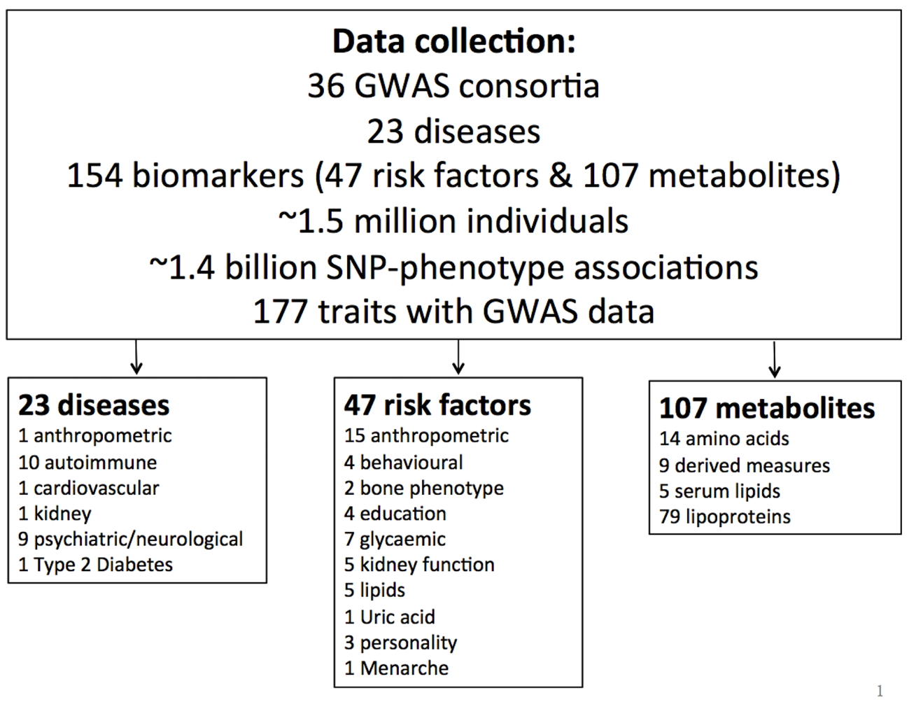
LD Hub database (v1.1)
Notes:
In LD Hub (v1.1), we selected high quality GWAS summary results of 177 unique traits, which included 23 diseases, 47 risk factors and 107 metabolites
219 traits now (1.3.1)

Slide 12
Why these datasets?
Non-sex stratified
White European ancestry
Traditional GWAS array
n>450k SNPs
Large sample sizes (n>5000)
Mean chi-square of test statistics >1

Slide 13
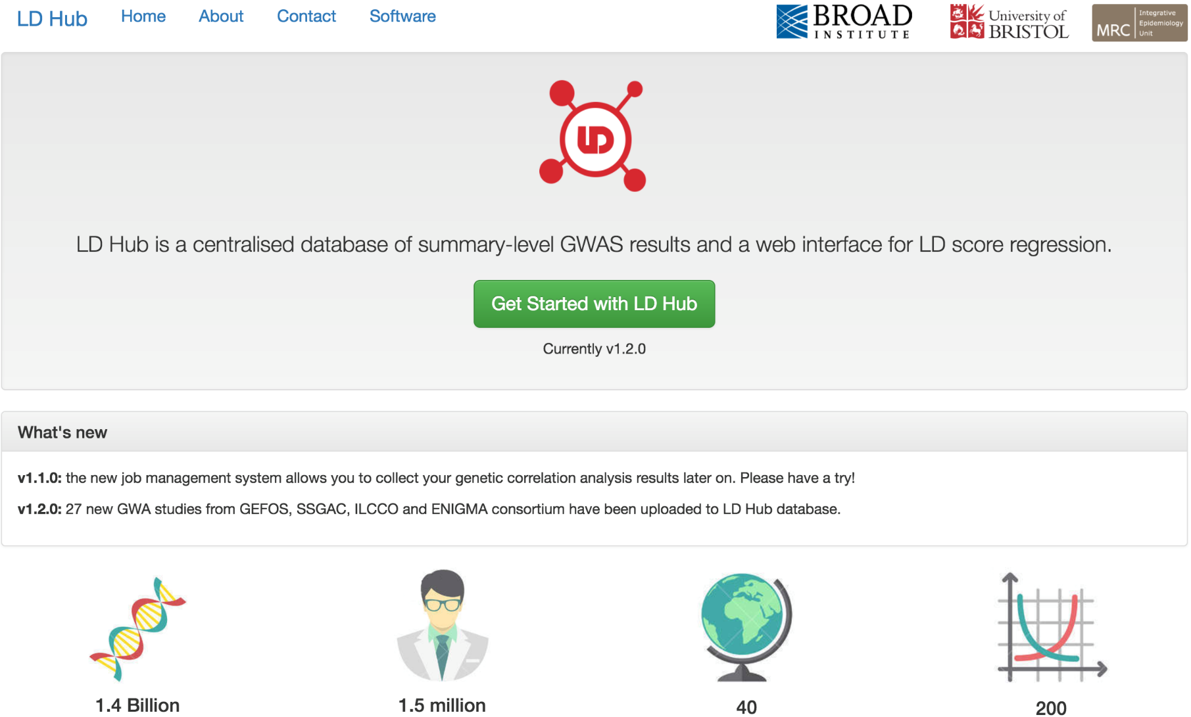
LD Hub web interface
ldsc.broadinstitute.org

Slide 14
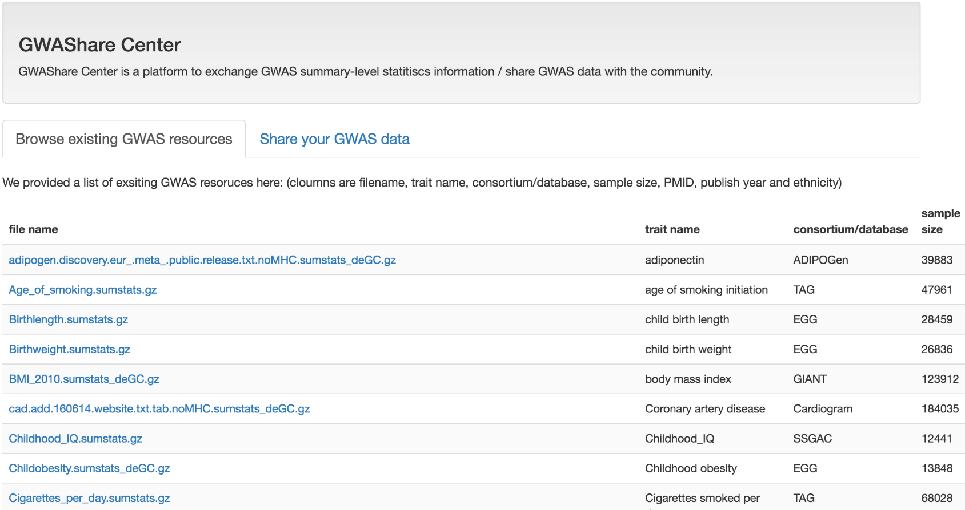
GWAShare Center
Data sharing “facilitator” rather than a repository
LD Hub is continually updated and always requesting new datasets
Users are encouraged to share the GWAS results with the community (see: Abraham M. 28/02/17. Don’t let useful data go to waste. Nature)
Notes:
GWAShare center for GWAS summary resources sharing (important)
LD hub also makes you aware of what’s publicly out there

Slide 15
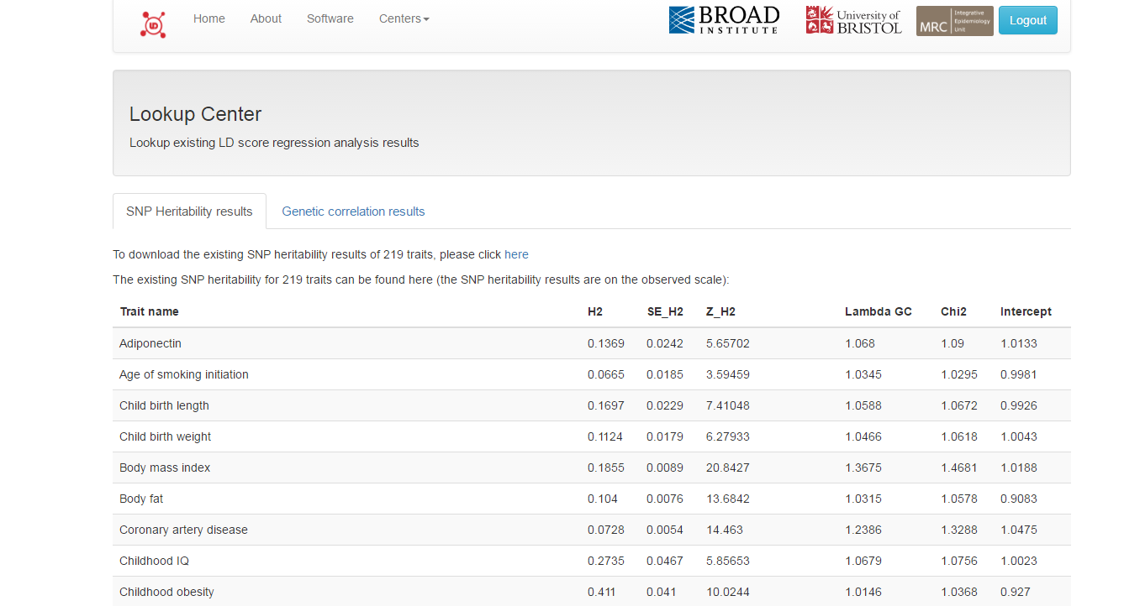
Lookup Center – SNP heritability
Comprehensive info on each study
H2: SNP heritability of trait
Z_H2: SNP heritability Z score
λ: Genomic inflation factor
Intercept: LD score regression intercept
Notes:
Info on studies: Download link, PMID, trait, Lambda, LD score regression intercept, ethnicities, sample size, n of SNPs

Slide 16
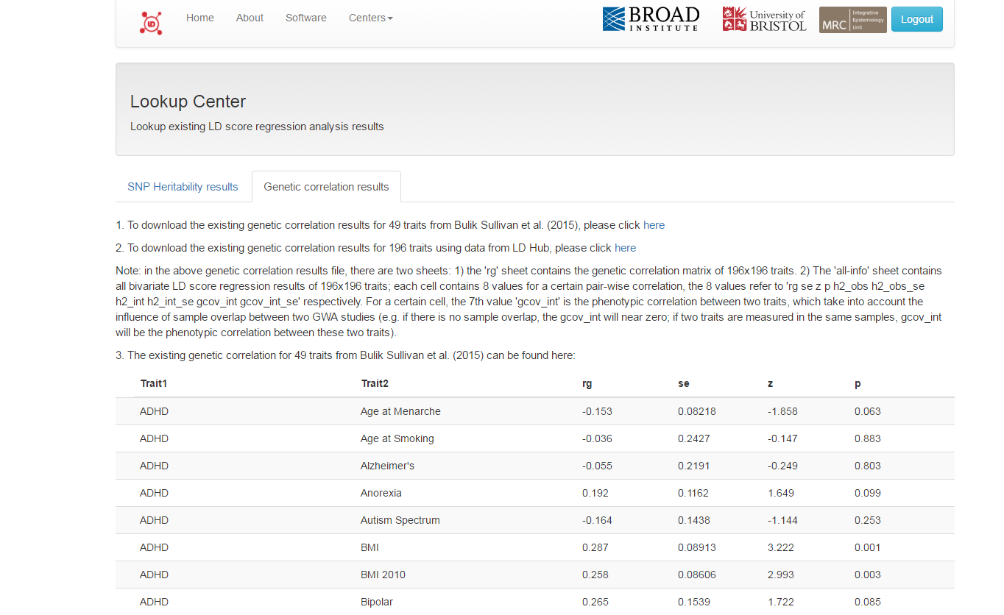
Lookup Center – Genetic correlation
Comprehensive info for each trait comparison
rg: Genetic correlation
gcov_int: phenotypic correlation between two traits, which takes into account the influence of sample overlap between two GWA studies (e.g. if there is no sample overlap, the gcov_int will be near zero; if two traits are measured in the same samples, gcov_int will be equal to the phenotypic correlation between these two traits)
Notes:
Info on trait comparisons: Genetic correlation (rG), P value, SNP heritability, Phenotypic correlation (gcov_int)

Slide 17
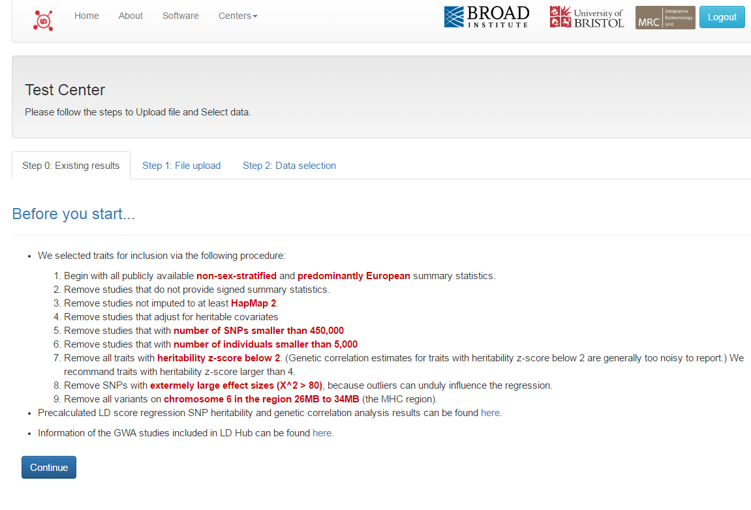
Test Center
Notes:
The test center allow users to upload their GWAS results, select GWAS of interests in LD Hub database, click go and collect the results, which greatly increase the speed of LD score regression analysis.

Slide 18
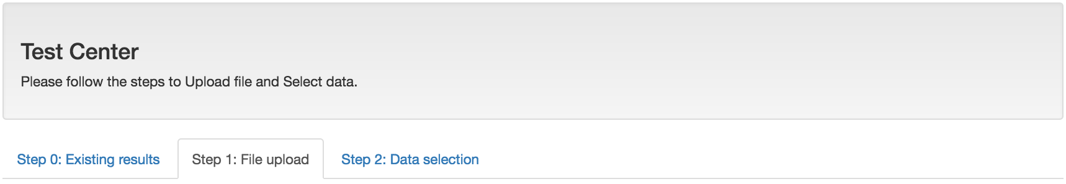
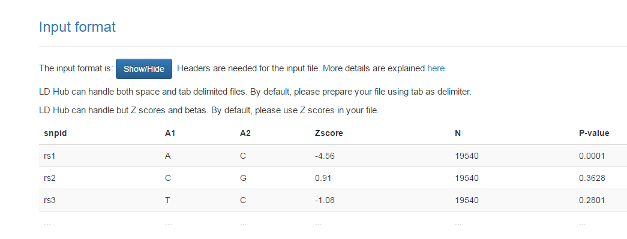
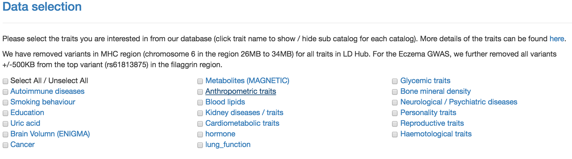

Slide 19
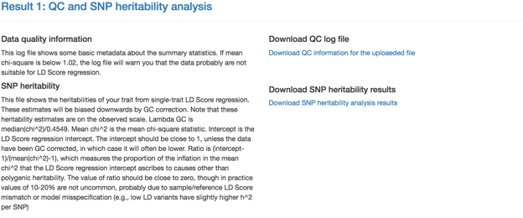
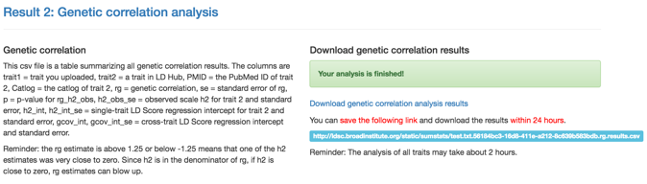
Notes:
Mean X2 below 1.02: GWAS trait is not polygenic enough

Slide 20
Automated QC
Once file is uploaded, the following QC steps are performed automatically by LD hub:
Filtering SNPs:
Keep MAF>5%
Remove those absent in HapMap phase 3 and with a 1000 Genomes EUR MAF <5%
Remove SNPs with effective sample size < sample size (90th percentile) x 0.67
Remove Indels and structural variants
Remove if alleles do not match those in 1000 Genomes
Remove SNPs in MHC region
Remove SNPs with chi-squared >80 (i.e. large β)

Slide 21
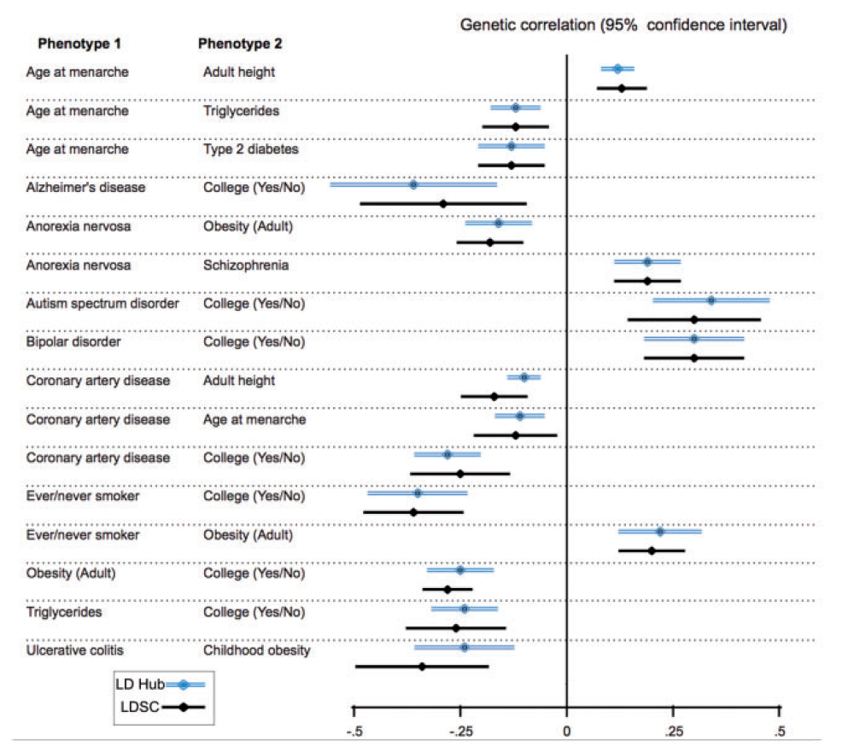
Results – LD hub reliability
LD hub results (blue) compared against previous results (Bulik-Sullivan et al, 2015, Nat Genet) – discrepancies due to new QC protocols and more recently published GWAS results
Notes:
Differences: More SNP coverage also, where applicable

Slide 22
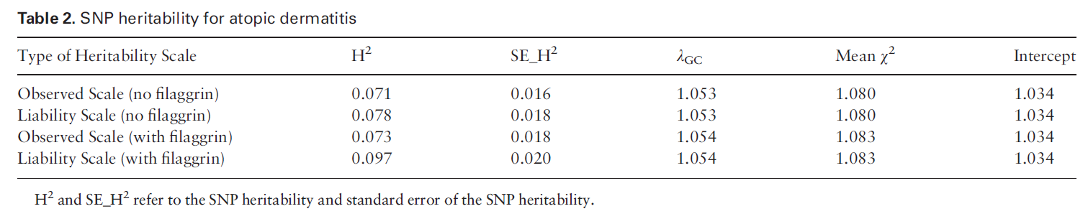
LD Hub application – atopic dermatitis
Twin studies suggest that eczema has a heritability of ~80%
LD score regression calculates H2 to be 7.8%
Narrow-sense heritability (i.e. SNP heritability)
Heterogeneity in EAGLE consortium’s atopic dermatitis cases

Slide 23
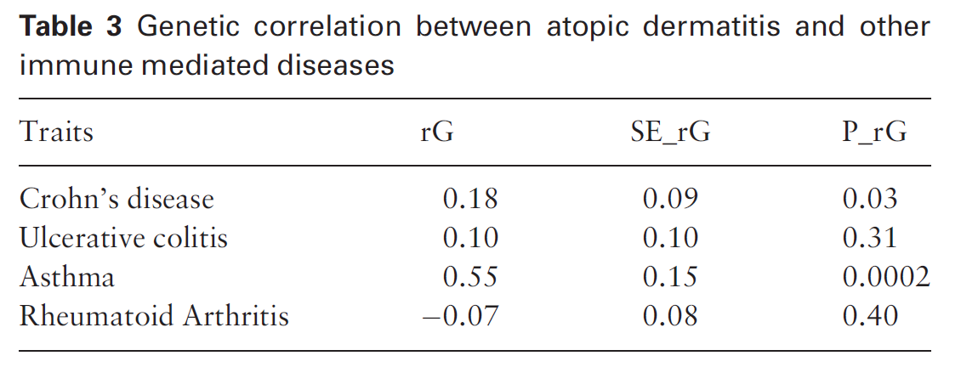
LD Hub application – atopic dermatitis (continued)
Well-known association between asthma and eczema replicated
Suggestion of correlation with other immune mediated diseases
Follow up with larger studies

Slide 24
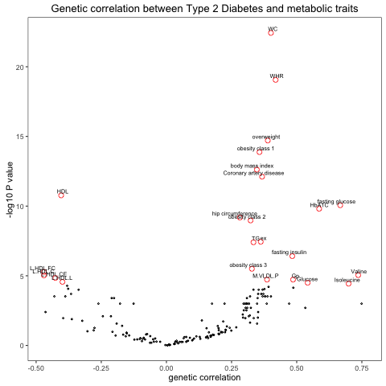
LD Hub application – Type 2 diabetes
Notes:
Volcano plot shows nice clusters e.g. weight-related traits, lipid-related traits, branch-chained amino acids (e.g. Isoleucine, Valine)

Slide 25
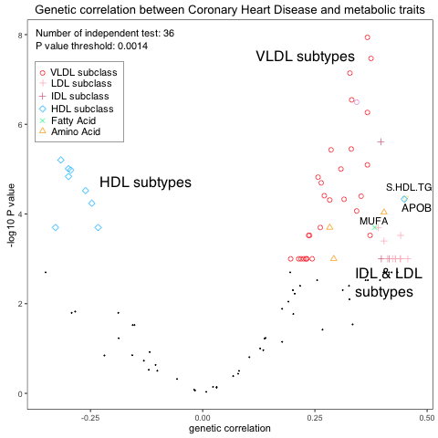
Genetic correlation between metabolites and CHD
Notes:
Volcano plot of genetic correlation between metabolites and CHD
Interesting: 1- APOB not clustering with other HDL subtypes
2- All VLDL, IDL and LDL subclasses were positively correlated with CHD.
3- Most of the HDL subclass were negatively correlated with CHD except small HDL (S.HDL.TG) were positively correlated with CHD
4- Another potential finding is monounsaturated fatty acid (MUFA) is positively correlated with CHD
5- Some amino acids, e.g. Valine, are positively correlated with CHD

Slide 26
Integrative analytical strategy of LD Hub and MR-Base
Two-step strategy:
Coronary Heart Disease and blood lipids
Hypothesis Generation using LD Hub
Hypothesis testing using MR-Base
Compare to Observational results
Trait 1 | Trait 2 | Method | r(G) | SE | P value
HDL | CAD | LDSC - rG | -0.314 | 0.042 | 5.0 x 10⁻¹⁴
LDL | CAD | LDSC - rG | 0.221 | 0.051 | 1.4 x 10⁻⁵
Exposure | Outcome | Method | Beta | SE | P value
HDL | CAD | MR - Egger | 0.056 | 0.087 | 0.52
LDL | CAD | MR - Egger | 0.443 | 0.061 | 1.12 x 10⁻¹⁰
Notes:
As a proof of principle, we test the genetic correlation of LDL/HDL and CHD using LD Hub. HDL show negative correlation while LDL show positive correlation to CHD. We further test the causality of these correlations. As expected, the correlation between HDL and CHD is not causal, and increase LDL level will casually increase the CHD risk.
This reduces unnecessary multiple testing in MR Base

Slide 27
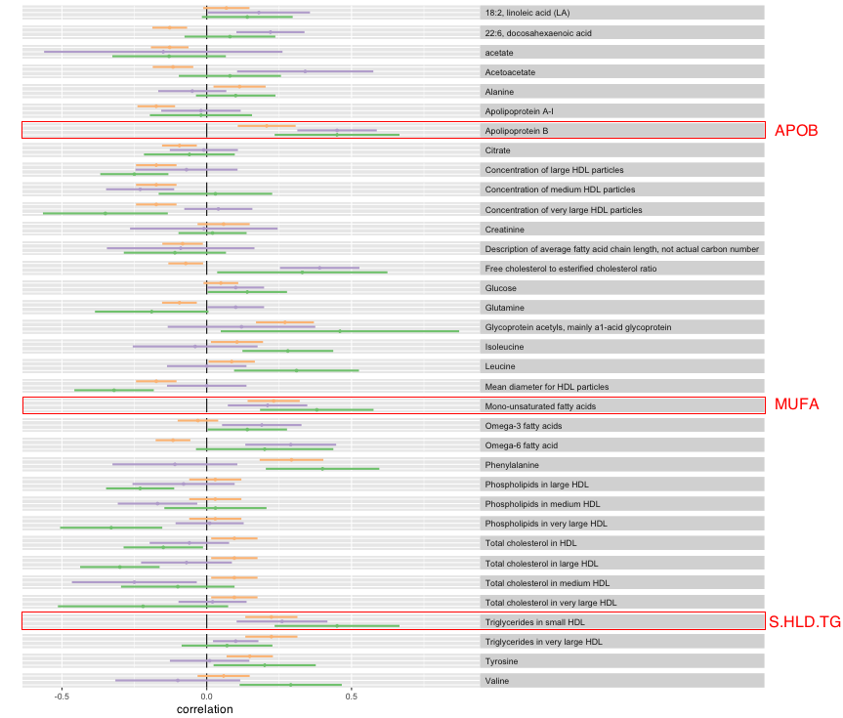
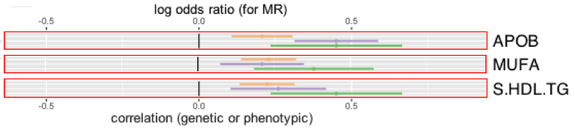
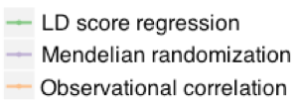
Three way comparison: metabolites causally correlated with CHD
Notes:
All three agree in direction
Digging more for the causal correlation using MR-Base, interesting findings including
1. APOB and MUFA is positively and potentially causally correlated with CHD
2. HDLs were not correlated with CHD as expected, but triglycerides in small HDL is positively correlated with CHD

Slide 28
Discussion & Next steps
Growing the database
Pre-existing / newly emerging GWASs
10000+ phenotypes in UK Biobank: 150K, 500K
Extending new methodology
Bivariate stratified LD score regression
Phenome-wide scan
Beyond genetics
Fine mapping
Annotations and enrichments
A Global GWAS summary results database
GWAS data from Eastern Asian and African
Notes:
Stratify – rather than compare the whole genome

Slide 29
Limitations of LD score regression
Data collection, harmonisation and QC was a time-consuming task
Solved with LD hub
Substantial differences between reference panel and GWAS sample in terms of ancestry
Inconsistency between LD patterns
Hopefully will be solved by LD hub with more published GWASs in different ethnicities
Not robust for all traits (e.g. if H2 is low)
Small sample sizes are also a problem
Use GCTA when n<3,000

Slide 30
Conclusions
LD hub: Large GWAS summary statistics database with 200+ traits
Fast bivariate LD score regression analysis: ~2 hours for all traits
User friendly: click and collect
~340 million possible pair-wise correlations amongst multiple GWAS
Standardized approached which improves robustness
Can be used to generate hypotheses

